Slide 1

Vel Tech Rangarajan Dr. Sagunthala R&D Institute of Science and Technology
School of Computing
Department of Computer Science and Engineering
10211CS224 / FULL STACK APPLICATION DEVELOPMENT (JAVA)
PROJECT REVIEW : MILESTONE PROJECT – 2
Date: 20-04-2026
JOB PORTAL MANAGEMENT SYSTEM
SDG: SDG 8 – Decent Work and Economic Growth
Presented By:
I.Keerthi Sree – VTU24645 – 23UECS0215
Courses Handling Faculty:
Dr. S . HEMAMALINI – M.E., Ph.D.,

Slide 2
INTRODUCTION
Background of the problem:
Manual job searching and recruitment are slow, unorganized, and inefficient.
Why this project is important:
It simplifies hiring by automating job posting, applications, and candidate management.
Real-world relevance:
Widely used by companies and job seekers to connect and streamline recruitment digitally.
Brief overview of the system:
A web-based portal where employers post jobs and candidates apply and track applications online.
1
2
3
4
5
6
7
8
9

Slide 3
PROBLEM STATEMENT
To design and develop a web-based Job Portal Management System.The system should connect job seekers and employers on a single platform.It should allow employers to post and manage job openings easily.Job seekers should be able to search and apply for jobs online.The system must store and manage application data efficiently.It should improve the overall recruitment process by reducing time and manual effort. It should provide secure login and profile management for users.The system should enable tracking of application status in real time.It should ensure a user-friendly interface for smooth navigation and usability.
1
2
3
4
5
6
7
8
9

Slide 4
OBJECTIVES
To develop a web-based platform that allows employers to post jobs and manage applications efficiently.
2. To provide a secure and user-friendly system for seamless interaction between employers and job seekers.
1
2
3
4
5
6
7
8
9

Slide 5
.
Admin can view and manage registered participants.
PROPOSED SYSTEM
The proposed system is a web-based Job Portal Management System.
2. It provides separate login access for admins, employers, and job seekers.
3. Employers can post, update, and manage job vacancies easily.
4. Job seekers can create profiles, upload resumes, and apply for jobs online.
5. The system allows searching and filtering of jobs based on skills and location.
6. It maintains a centralized database for storing user and job details.
7. Admins can monitor activities and manage users efficiently.
8. The system ensures secure, fast, and user-friendly recruitment management.
1
2
3
4
5
6
7
8
9

Slide 6
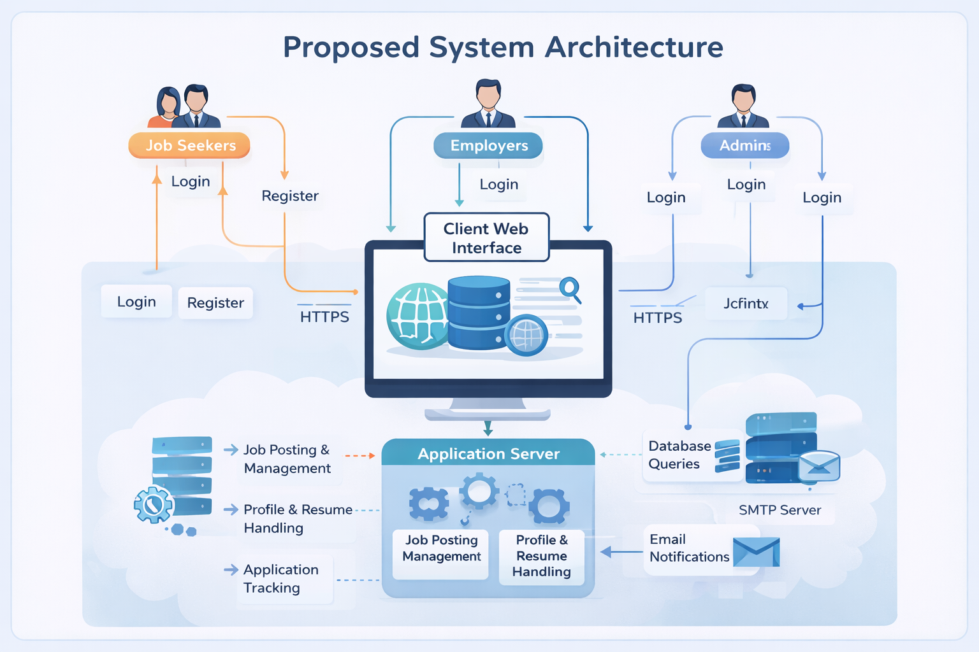
PROPOSED SYSTEM ARCHITECTURE
1
2
3
4
5
6
7
8
9

Slide 7
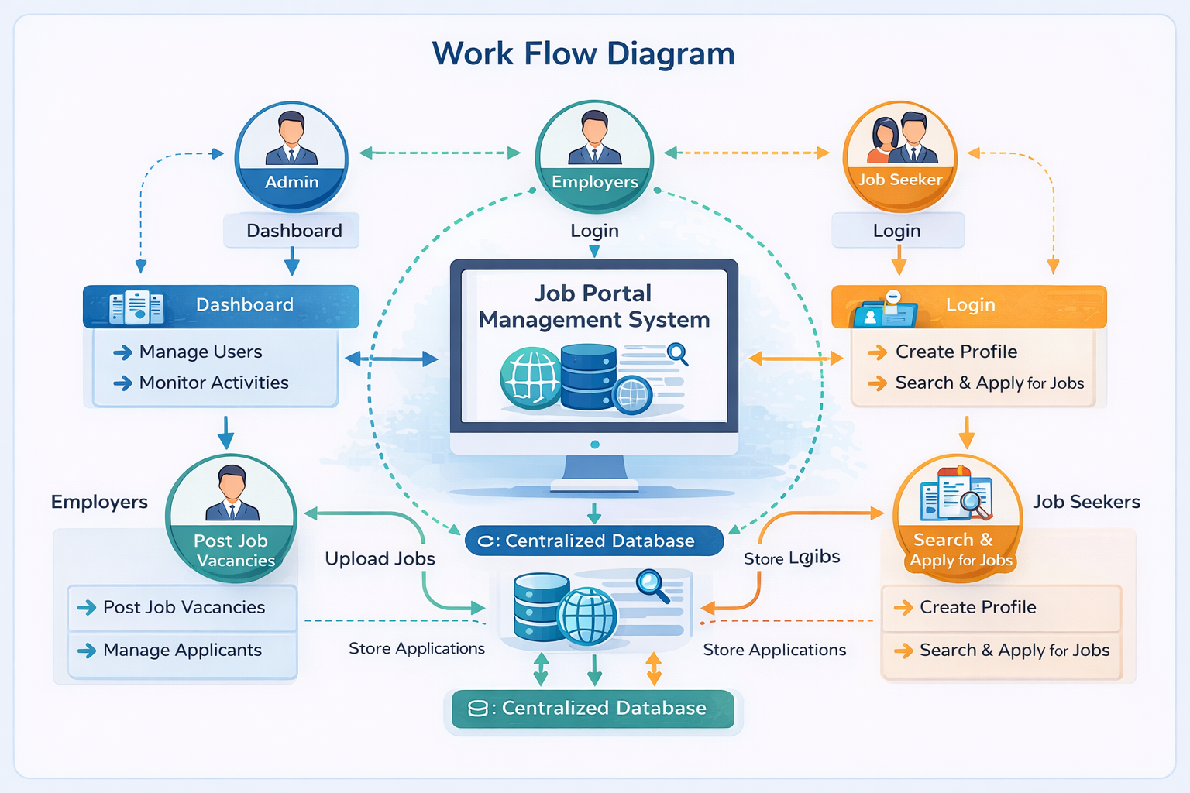
WORKFLOW
1
2
3
4
5
6
7
8
9

Slide 8
TECHNOLOGIES USED
Frontend:
1.HTML5
2.CSS3
3.Javascript
Backend:
1.Java Spring Boot
Database:
MySQL
Spring Data JPA
Server:
XAMPP (Apache Server + MySQL)
Tools:
1.Web Browser (Chrome / Edge)
2. Google ai
1
2
3
4
5
6
7
8
9

Slide 9
MODULE DESCRIPTION
1
Module 1: User Management
Manages users, monitors system activities, and controls overall system operations.
Module 2: Event Management
Allows employers to post jobs, update vacancies, and manage applicants.
Module 3: Registration Management
Enables users to register, create profiles, search jobs, and apply online.
Module 4: Database Management
Handles job applications, tracks status, and manages communication between employers and job seekers.
2
3
4
5
6
7
8
9

Slide 10
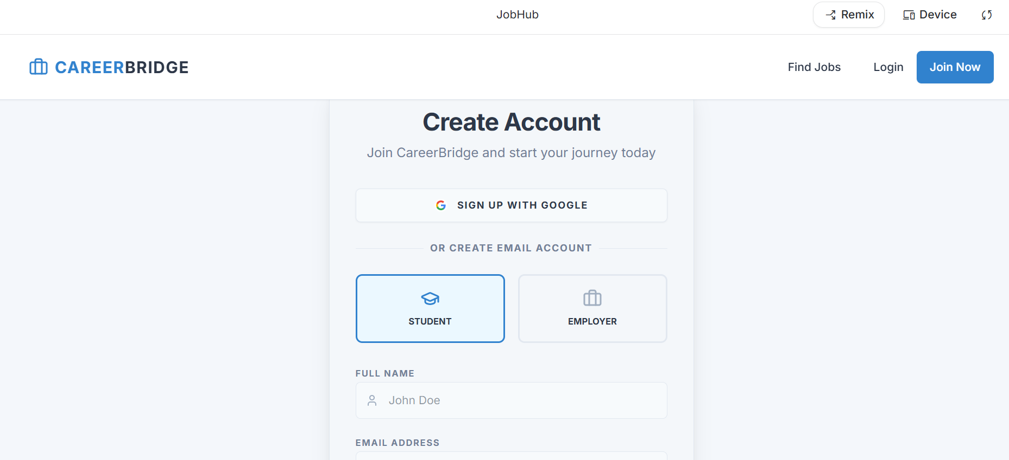
IMPLEMENTATION SCREENSHOTS
Login Page:
1
2
3
4
5
6
7
8
9

Slide 11
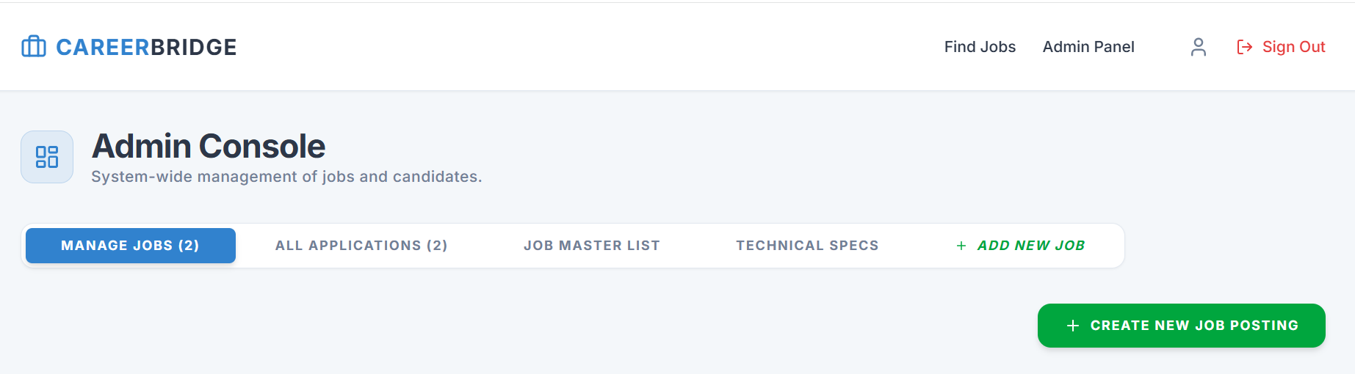
IMPLEMENTATION SCREENSHOTS
Admin Login Page :
1
2
3
4
5
6
7
8(A)
9

Slide 12
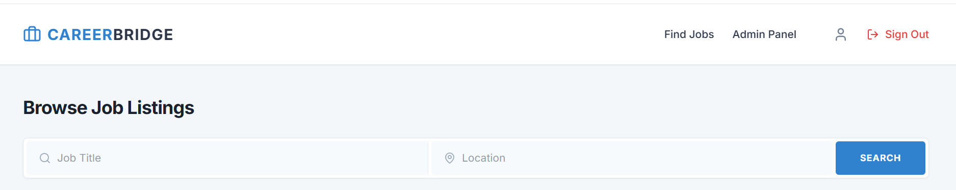
IMPLEMENTATION SCREENSHOTS
1
2
3
4
5
6
7
8(B)
9

Slide 13
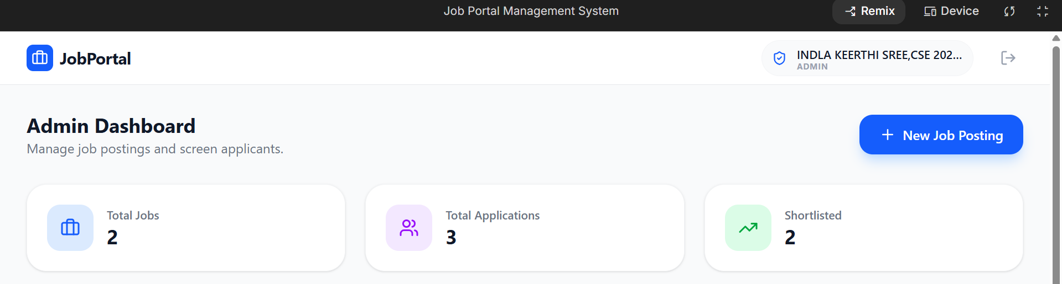
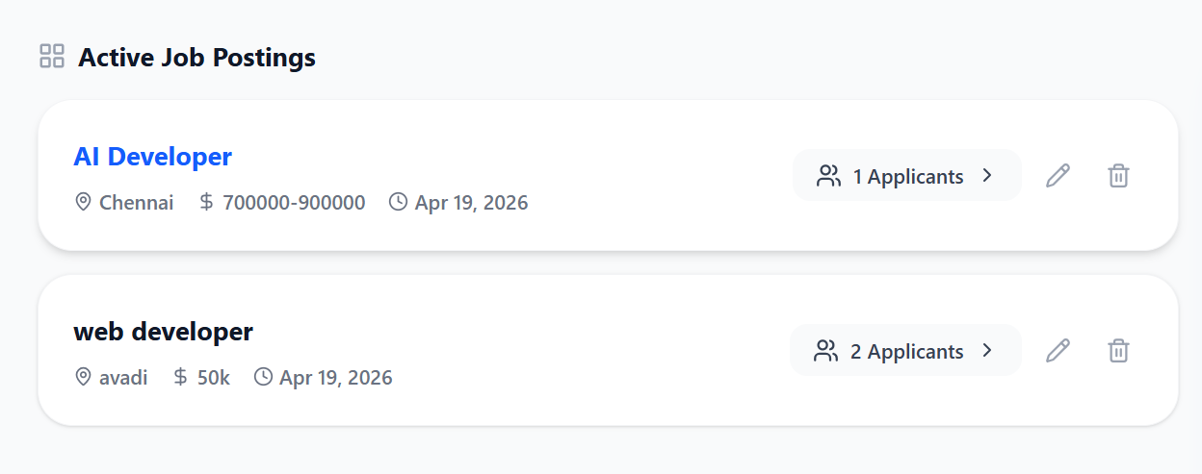
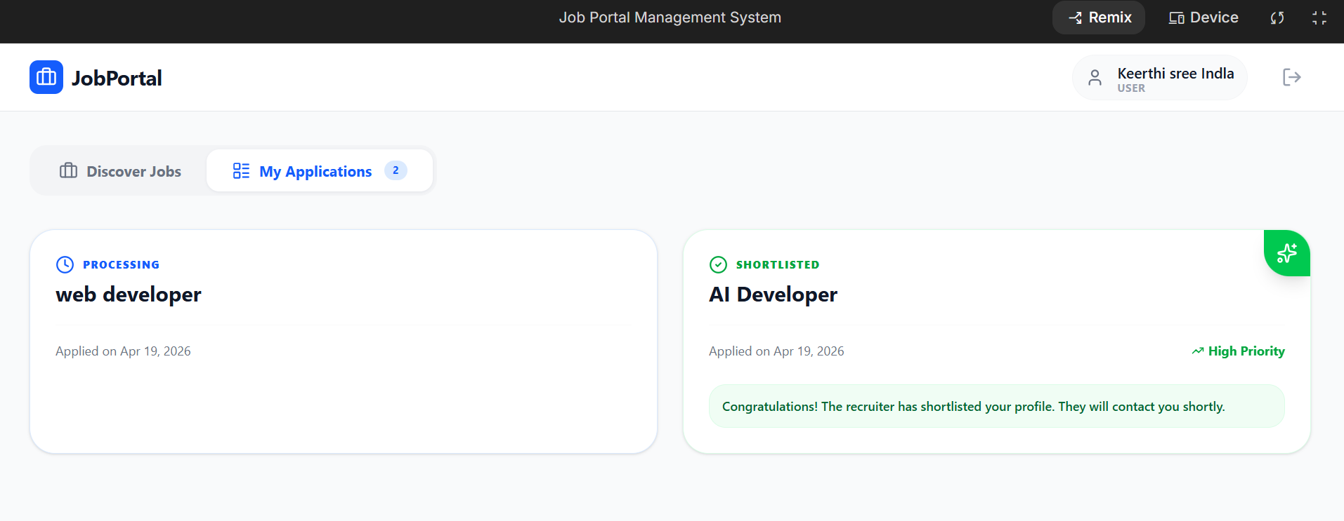
IMPLEMENTATION SCREENSHOTS
1
2
3
4
5
6
7
8(C)
9

Slide 14
ADVANTAGES & LIMITATIONS
Advantages:
Reduces manual work and speeds up the recruitment process.
Provides a centralized platform for job seekers and employers.
Easy to access and use from anywhere through the web.
Improves data management and tracking of applications.
Limitations:
Requires internet connection to access the system.
Data security and privacy risks if not properly managed.
Depends on system maintenance and regular updates.
Limited functionality if not integrated with advanced features.
1
2
3
4
5
6
7
8
9

Slide 15
Thank you

